Slide 1

Introduction to Entrepreneurship
Dr. Zunaira Saqib

Slide 2

Week 13: Franchising, Social Entrepreneurship and Local Opportunities

Slide 3

What Is Franchising?
An arrangement whereby a party (franchisor), who has developed a way of running a business format/system successfully, licenses the rights to operate that format/system using his trademark, name or other IP rights to another party (franchisee)

Slide 4

Why Franchise?
A recognised brand name
Enhanced business image
Consistent quality

Slide 5
Why Franchise?
Franchises offer important pre-opening support:
Site selection
Design and construction
Financing (in some cases)
Training
Grand-opening program

Slide 6
Why Franchise?
Franchises offer ongoing support
Training
National and regional advertising
Operating procedures and operational assistance
Supervision and management support
Increased spending power, access to bulk purchasing and economies of scale

Slide 7
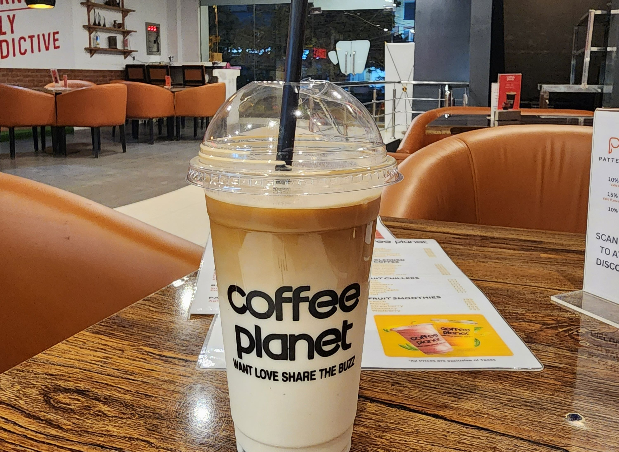
Disadvantages
The franchisee is not completely independent.
In addition to the initial franchise fee, franchisees must pay ongoing royalties and advertising fees.
Franchisees must be careful to balance restrictions and support provided by the franchisor with their own ability to manage their business

Slide 8

Disadvantages
A damaged, system-wide image can result if other franchisees are performing poorly, or the franchisor runs into an unforeseen problem.
The term (duration) of a franchise agreement is usually limited and the franchisee may have little or no say about the terms of a termination

Slide 9
How To Assess A Prospective Franchise?
Assess the reputation and reliability of the franchisor
Find out the demand for the goods/services offered in the franchise
Do sales projection
Find out from other franchisees the support services provided
Work out the amount of capital that is needed upfront

Slide 10
What Is Involved In Franchising?
Tenure/Period of contract
Initial fee
Royalty/management fee
Renovation cost
Territory
Supply of goods and services
Compliance with contract
Terms of termination

Slide 11

Types Of Franchise
Product distribution franchises
Business format franchises.

Slide 12
Product Distribution Franchises
A product distribution franchise model is very much like a supplier-dealer relationship.
Typically, the franchisee merely sells the franchisor’s products.

Slide 13



Product Distribution Franchises
Examples of famous product distribution franchises include:

Slide 14

Product Distribution Franchises
Produces the syrup concentrate
Sells the syrup concentrate
FRANCHISEE
Produces the final drink
Retail Stores
Vending Machine Operators
Restaurants & F&B Outlets

Slide 15
Business Format Franchising
The franchisee not only distributes the franchisor’s products and services under the franchisor’s trademark, but also implements the franchisor’s complete method to conduct the business itself.

Slide 16
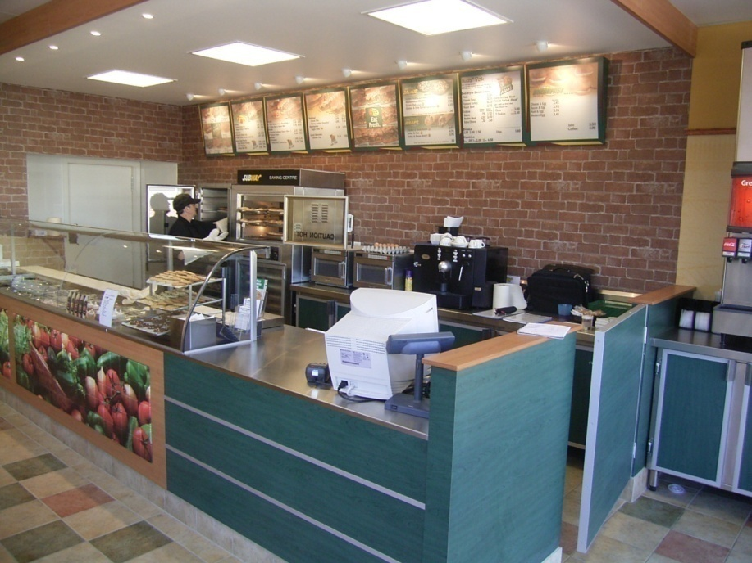

Business Format Franchising
Examples of famous business format franchises include:

Slide 17

Explore
https://www.franchisepk.com/

Slide 18

Social Entrepreneurship

Slide 19
Social Entrepreneurship
Social entrepreneurship is the activity of establishing new business ventures to achieve social change. The business utilises creativity and innovation to bring social, financial, service, educational or other community benefits (Talbot, Tregilgas & Harrison, 2002)
Social enterprises are not charities or welfare agencies. They are private businesses established by entrepreneurs with an emphasis on human values rather than just profit.

Slide 20


Challenge: Access to Clean Water
1.2 billion people are drinking unsafe water
Problem: transport (retrieval to consumption)
Seeding innovation in the water sector

Slide 21

Functions of Social Entrepreneurship
To address social problems inadequately addressed by government
To provide urgent but sustainable solutions to the most difficult problems

Slide 22

Deference between Entrepreneurship and Social Entrepreneurship
Entrepreneurship Social Entrepreneurship
Economic value Social value
Customer Society
Wealth maximization Social value
Indirect link to social Direct link to social

Slide 23

The Process of Social Entrepreneurship
Find an opportunity
Develop a business concept
Figure out what success means and how to measure it
Acquire the right resources
Launch and grow
Attain goals

Slide 24

The Main Difficulty: Measurement
What is profit?
How do we count it?
What is “social return on investment” for venture philanthropists?
The case of Abey Khao

Slide 25

Local Opportunities
NICs
NSTP
Ignite
HEC
Startup.Punjab
Karnandaaz
Embassies
Local investors
Accelerator Prosperity

Slide 26
Final Presentation and Business Plan
Final Delivery of the Start up

Slide 27

Final Report of your Startup
8% Business Plan due on 24th May, Friday, at 11am only on LMS
No late submissions accepted

Slide 28

7% Presentations – 17th May, Friday
Submission of ppt + video + prototype by 16th May 2024 11pm https://drive.google.com/drive/folders/1YrjLwHvxZhpdIiLjohYHx9ojDSl_0VwV?usp=sharing
8:45am start
5 Minutes Ppt
Company, Logo, Tag Line
Problem and Solution (20%)
Industry Analysis and USP(20%)
Funding need and why (30%)
Prototype Presentation/ Show (30%)
5 Minutes Q and A
To the point and short answers
Professionalism (Attire and Attitude)

Slide 29
Judges
Mr. Asher Saeed
Mr. Faisal Jamil
Mr. Parvez Abbasi
Mr. Adeel Saeed
Ms. Ayesha Raza
Dr. Saqib Ali
Dr. Muslim Shah
Founder & CEO at KytherTek
Vice President of Customer Success LMKR
Founder Adventure
CEO / Co-founder at Stech.ai & Botwa.ai
Founder EdDeaf and Abey Khao
DCM Nescom
DCM Nescom

Slide 30
8% Business Plan – 25th May 2024
Soft copy only on LMS
Business Plan + Excel File
Word Limit 5000 (If needs exceeding, Discuss)
Should Include
Introduction, Company, logo, and Team Description
Problem and Solution (20%)
Industry Analysis, Competitors Analysis and USP (10%)
Target Market and Customer Personas, Social Media Setups (100 likes) and Static Website (Include Links for Checking) (30%)
Financial Evaluation of Two Years Including Funding Need and Why (20%)
Prototype Links / Presentation/ Show (20%)

Slide 31

What Does a Business Plan Include
Written document that outlines
Your Idea and Strategies for Launching
Your Financial Evaluation to Say Idea is Feasible

Slide 32

Introduction
Executive summary
Summary of rest of the document
Your company
Company’s name
Logo
Tag Line
Your team
Intro of team members
What are their expertise?

Slide 33

Problem
What problem are you solving?
What are customers pain point?
Why is it an important problem to solve?

Slide 34
Solution
What exactly is your solution?
How is it solving the pain points you mentioned earlier?
How is it going to make a difference in customer’s life?
Why are you the right team to solve this problem?

Slide 35
Industry Analysis
What are the industry statistics?
Do the statistics support your idea and solution?
What are the global industry and local industry statistics?
What are your marketing research results?
The porter’s five forces.

Slide 36

Competitors Analysis
Who are your direct and indirect competitors?
Why do you consider them your competitors?
How are they solving the problem and how are you doing it better?

Slide 37
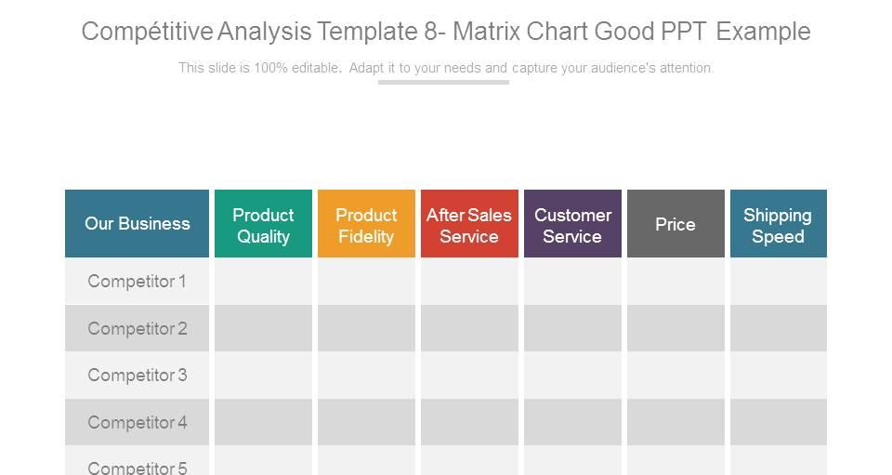

Slide 38
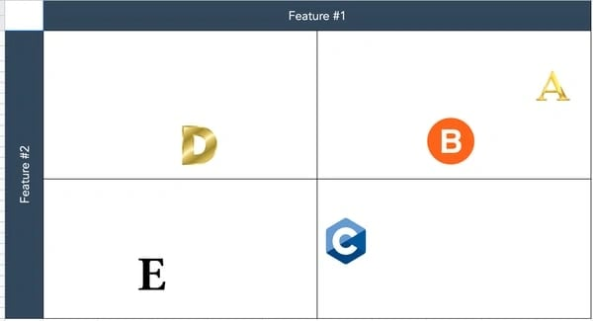

Slide 39

USP
How is the problem being solved right now and what makes you different?
What exactly is your USP and is it sustainable?

Slide 40
Target Market
What is your broader target market?
What are the demographics?
What are the psychographics?

Slide 41
Customer Personas
Define at least two customers personas

Slide 42


Slide 43
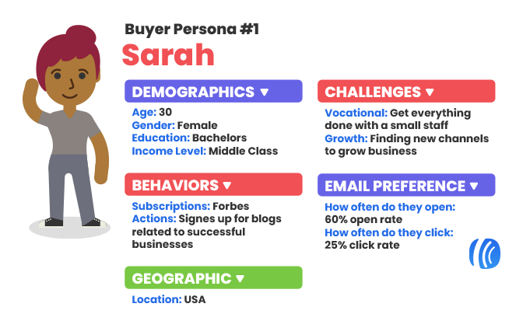

Slide 44
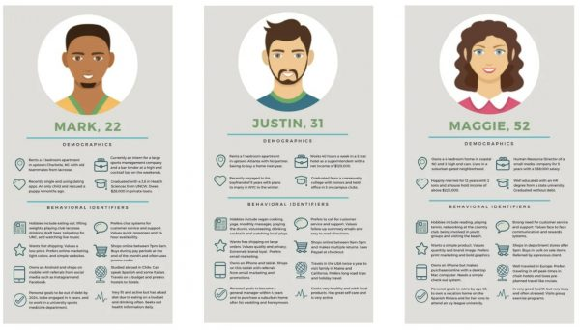

Slide 45

Social Media Setups
Setup Facebook, Instagram and LinkedIn
Have 100 liked each for Facebook and Instagram and 30 for LinkedIn
Have
Intro post
Team intro
Product info

Slide 46

Static Website
Simple static website having and explaining
Logo and tagline
Your company intro
Product info
Social media links

Slide 47

Financial Evaluation
Include complete excel file along with the business plan
The valuation should be based on some logic
Explain the logic in the document with important figures

Slide 48
Prototype / MVP / Video
MVP
Prototype
Video Demo

